Slide 1

Introduction to web programming(bplck205a) mini project
Department of Computer Science and Engineering
online grocery mart
Team : TEAM SRVS
Team Leader : Rakshith K N
Team Members: Sanjay B (1TJ22CS096)
Rakshith K N (1TJ22CS085)
Sankethmanoharan (1TJ22CS098)
Vinay N (1TJ22CS120)
Branch : CSE 2nd sem
Section : B sec
Guide Name : DR. Asha S Manek
Designation : Professor
T . John Institute of Technology,
Bangalore

Slide 2
AGENDA
wright 50words about online grocery shopilg
Abstract
Introduction
Webpages
Proposed system
Conclusion
Reference

Slide 3
Abstract
Online grocery shopping is a convenient and time-saving way to purchase groceries from the comfort of your home. With a vast selection of products, competitive prices, and doorstep delivery.
Customers can easily compare items, access exclusive deals, and enjoy contactless transactions, making it an increasingly popular choice for modern consumers.

Slide 4
Introduction
Online shopping is the activity of buying products and services over the internet using a web browser or mobile app..
Aims to revolutionize the way you shop for groceries.
Convenience, variety, and seamless shopping experience.
From user-friendly interfaces to secure payment gateways, creating an online shopping platform presents a unique opportunity to revolutionize the way we buy and sell goods in the 21st century.
As technology continues to advance, online shopping is expected to further shape the future of retail, providing an immersive and personalized shopping experience for consumers worldwide

Slide 5
Web pages
HOME
Product description
Customer details page
Order place
Delivery details
Order tracking
Feed back

Slide 6

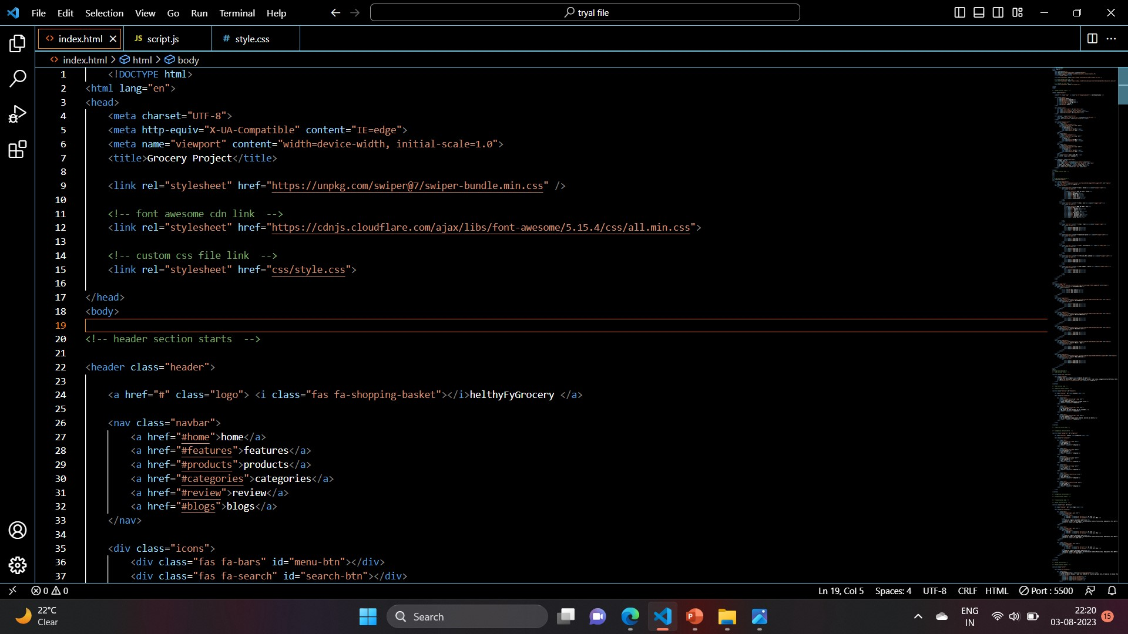
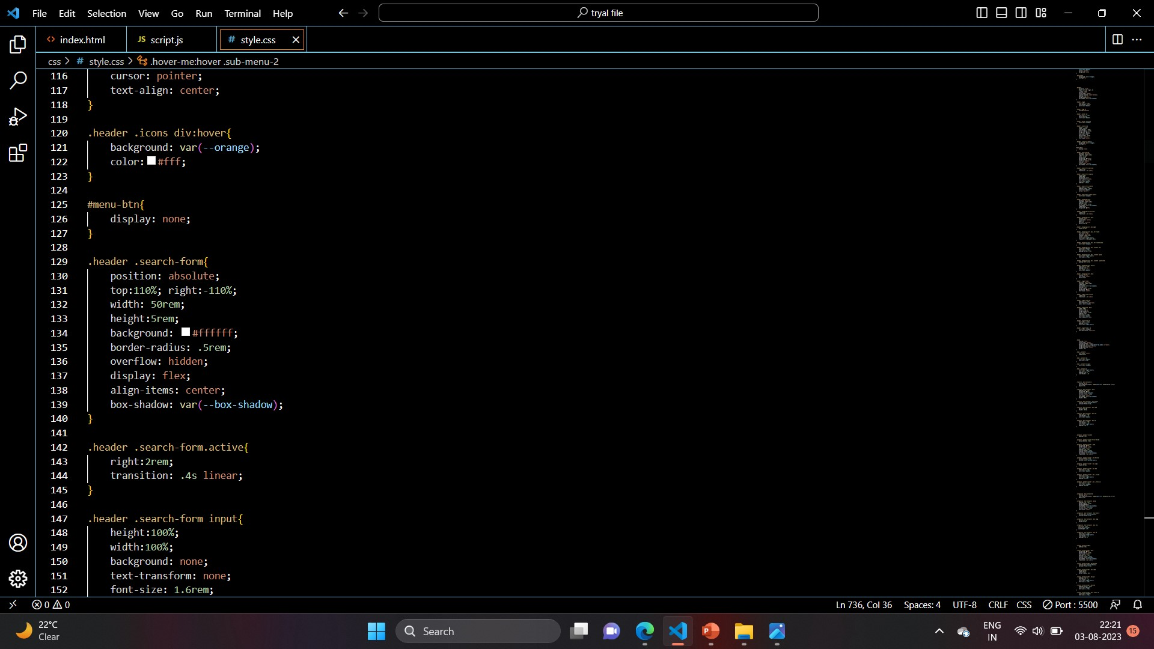
Proposed System
We have used a HTML and CSS code to develop a online web site .
The flatform we used to code the website is VS(Visual Studio). Which is one of the best flatform to code any code language.
Some of the code pics we coded to develop a web site is shown below:
Grocery Project

Slide 7
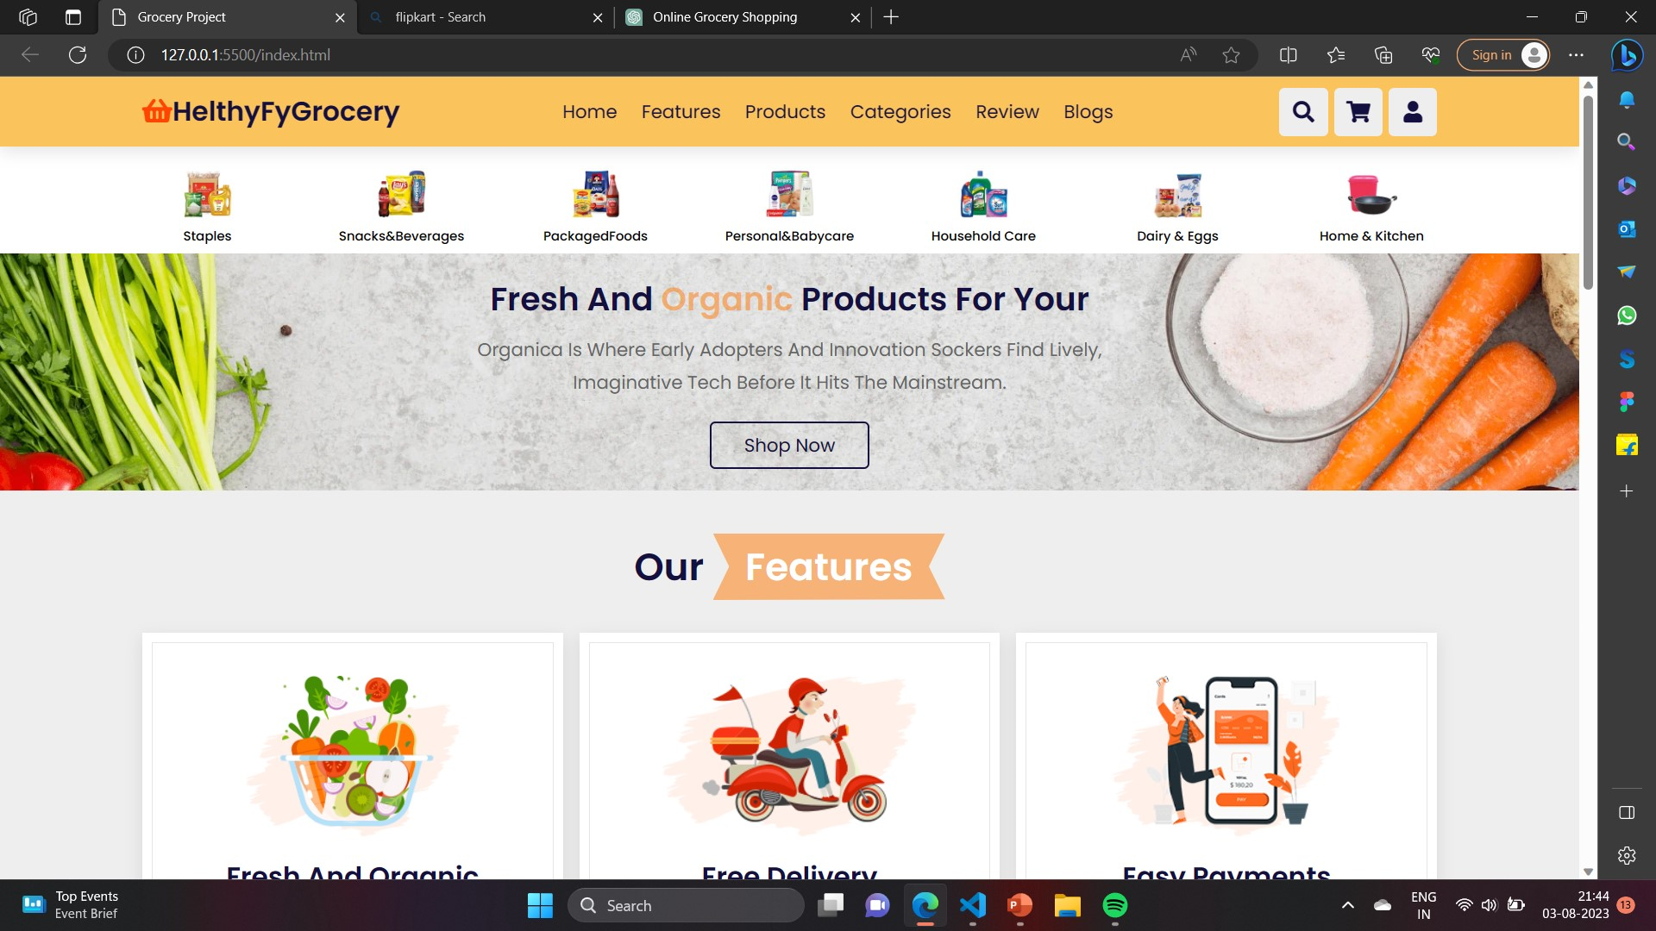
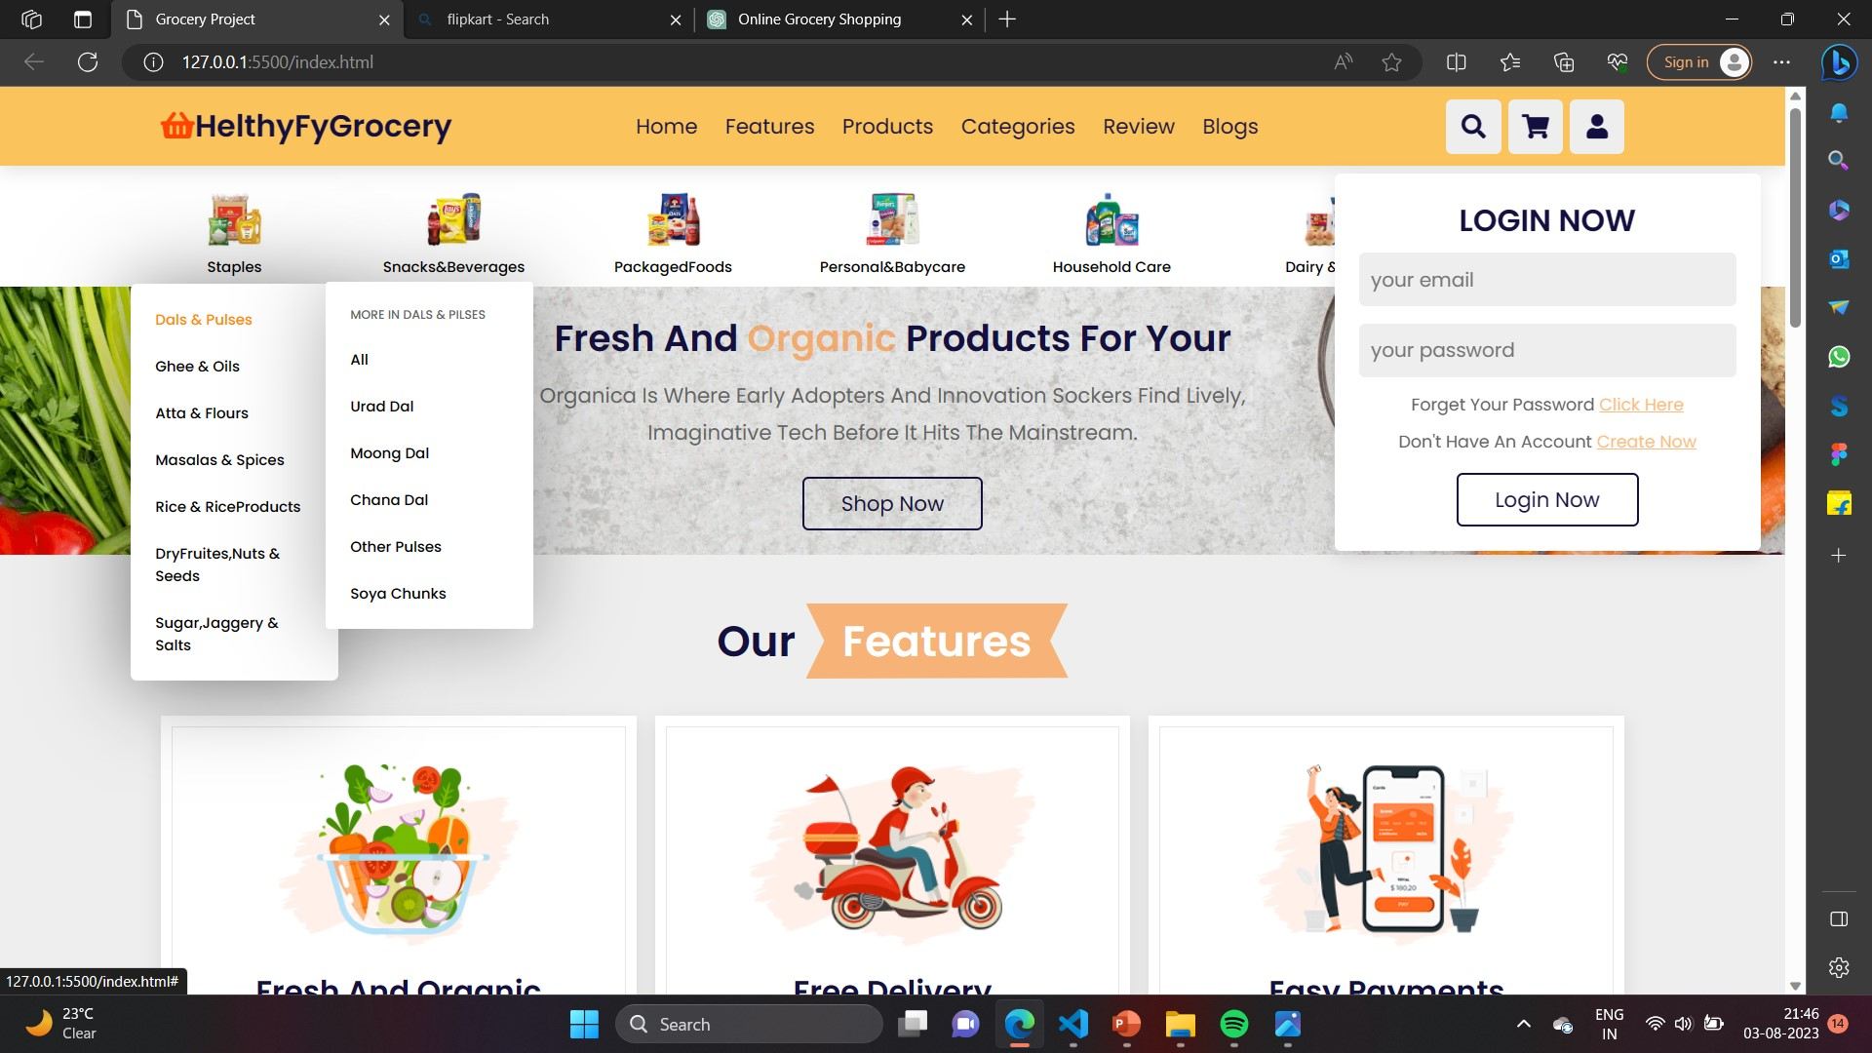
Web Pages pics

Slide 8
Conclusion
Online shopping allows access to merchandise solid world wide and is time –saving and convenient
In the future, we can expect online stores to improve their technology , making way for a much easier and faster shopping experience
The Shopping cart is mainly useful for who haven’t time to go to shopping.
Especially important during pandemic times, online shopping reduces the need for physical contact, promoting safety.
Overall, online grocery shopping can be a fantastic option for many people due to its convenience and efficiency. However, it's essential to weigh the pros and cons based on your specific needs, preferences, and circumstances.

Slide 9
Reference
Some of our reference sources we use to develop the website is Youtube(Apna Kaksha) , and some of the web developing programming books(M C Grohil).

Slide 10
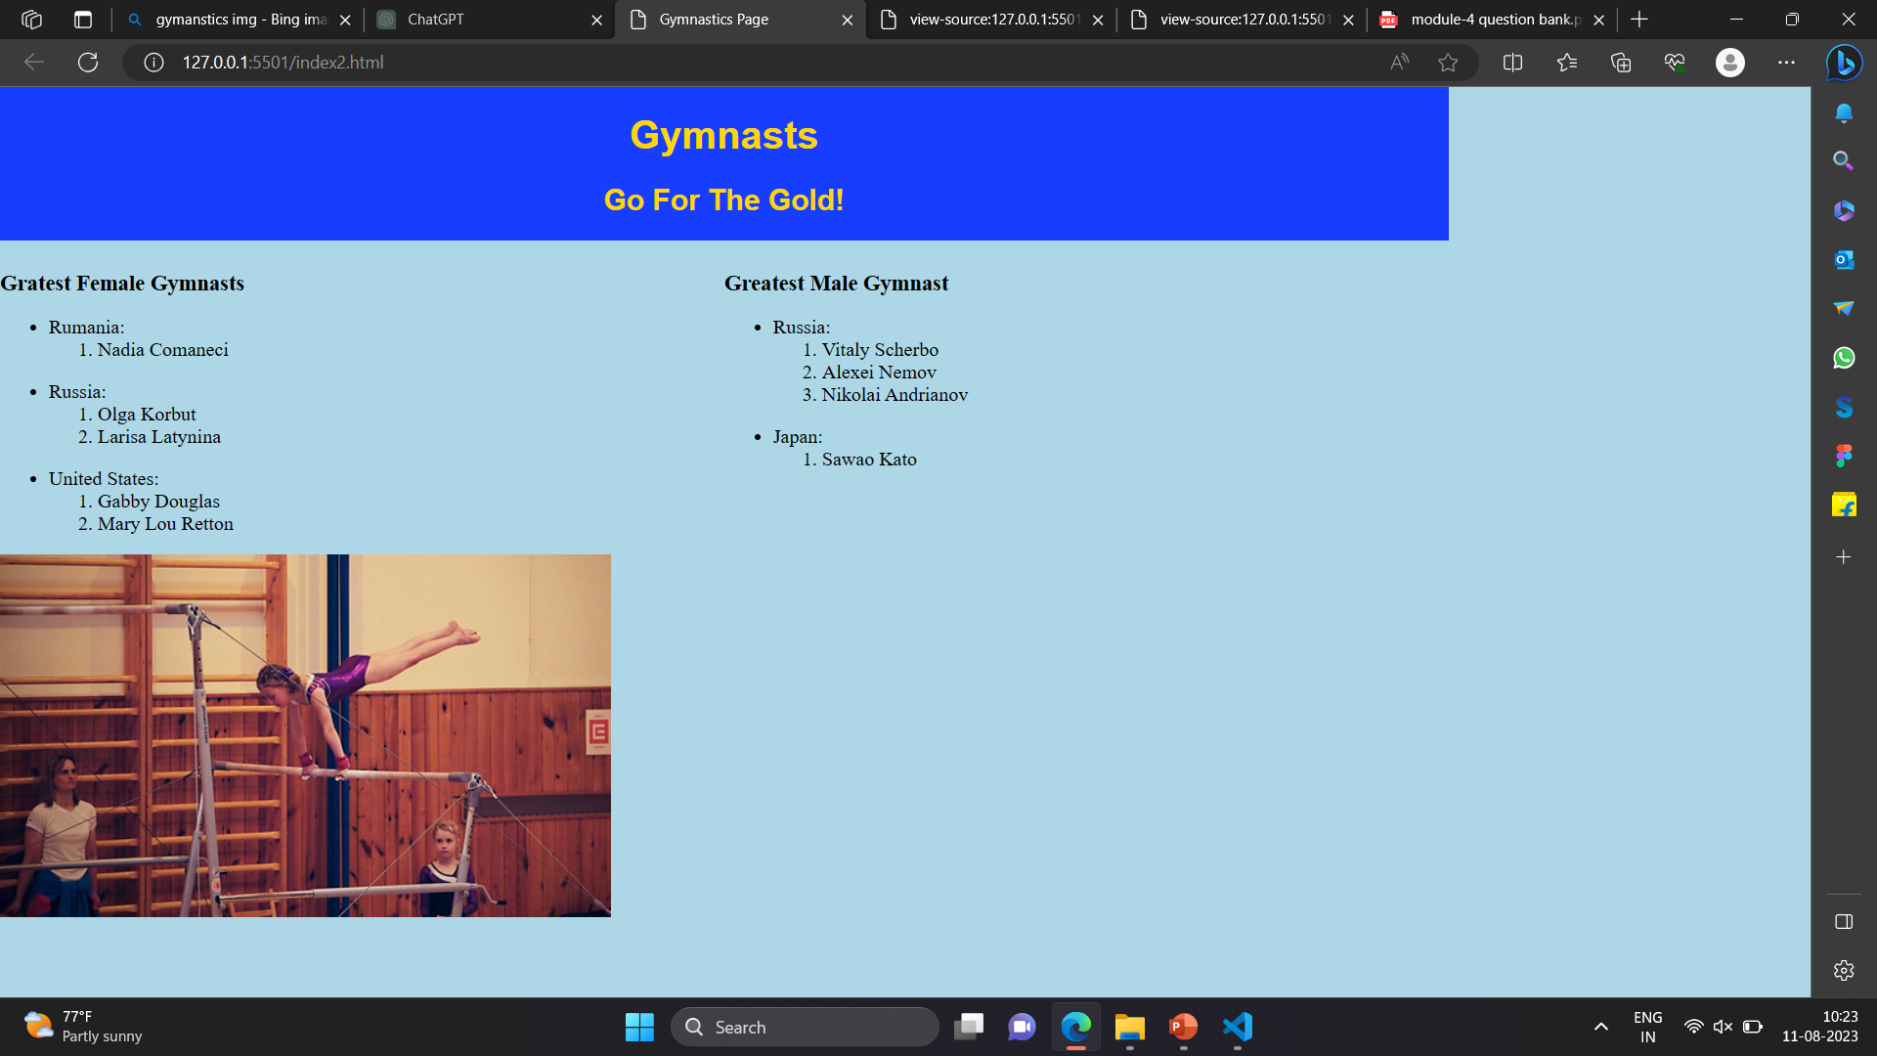
Gymnastics.html
Gymnastics Page

Slide 11
THANK YOU

